Slide 1
Progress Report Multicontact Capturability/Height Variations
GABRIEL ENRIQUE GARCÍA CHÁVEZ
2019

Slide 2

Full Centroidal Dynamics - FCD
In $ζ_{v}$:
$$ζ_{i}=\left[\begin{aligned}f_{i} \\ τ_{i}\end{aligned}\right],ζ_{v}=\left[\begin{aligned}ζ_{1} \\ ⋮ \\ ζ_{n}\end{aligned}\right]$$
$$\left\{\begin{aligned}\dot{L}=\sum_{i}{\left(τ_{i}+\left(r_{p0i}−r\right)×f_{i}\right)} \\ \ddot{r}=\frac{1}{m}\sum_{i}{f_{i}}+g \end{aligned}\right.,W_{bCWC}ζ_{v}≤b_{bCWC}$$
Use instead
$$L_{2}=L+m(r×\dot{r})$$

Slide 3
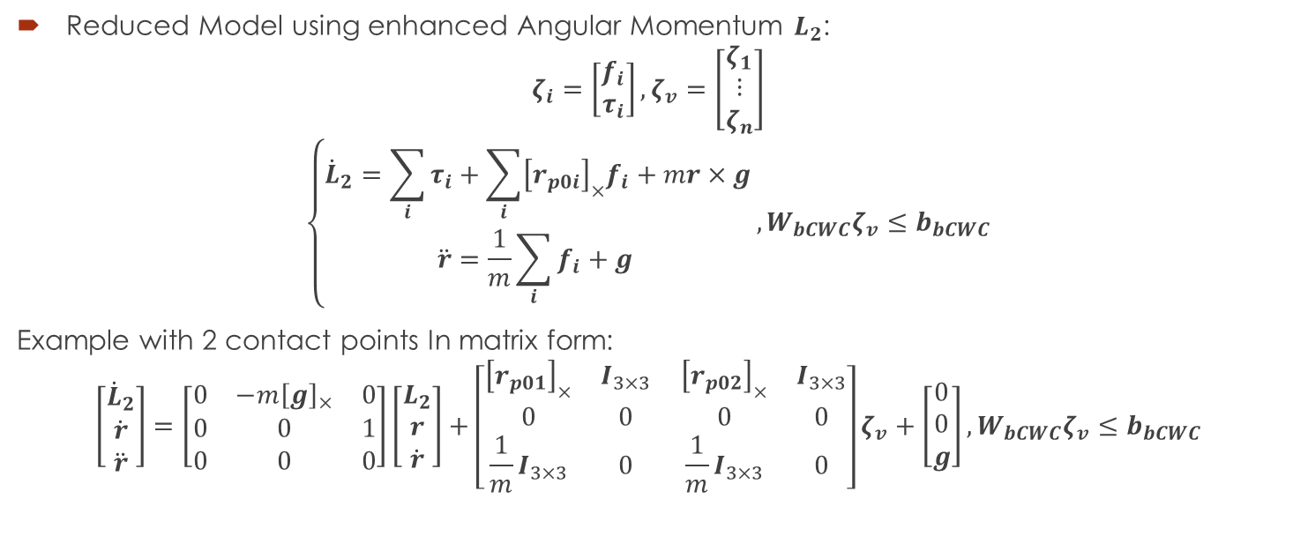
Full Centroidal Dynamics - FCD
Reduced Model using enhanced Angular Momentum $L_{2}$:
$$ζ_{i}=\left[\begin{aligned}f_{i} \\ τ_{i}\end{aligned}\right],ζ_{v}=\left[\begin{aligned}ζ_{1} \\ ⋮ \\ ζ_{n}\end{aligned}\right]$$
$$\left\{\begin{aligned}{\dot{L}}_{2}=\sum_{i}{τ_{i}}+\sum_{i}{{\left[r_{p0i}\right]}_{×}f_{i}}+mr×g \\ \ddot{r}=\frac{1}{m}\sum_{i}{f_{i}}+g \end{aligned}\right.,W_{bCWC}ζ_{v}≤b_{bCWC}$$
Example with 2 contact points In matrix form:
$$\left[\begin{aligned}{\dot{L}}_{2} \\ \dot{r} \\ \ddot{r}\end{aligned}\right]=\left[\begin{matrix}0 & −m{\left[g\right]}_{×} & 0 \\ 0 & 0 & 1 \\ 0 & 0 & 0\end{matrix}\right]\left[\begin{aligned}L_{2} \\ r \\ \dot{r}\end{aligned}\right]+\left[\begin{matrix}{\left[r_{p01}\right]}_{×} & I_{3×3} \\ 0 & 0 \\ \frac{1}{m}I_{3×3} & 0\end{matrix} \begin{matrix}{\left[r_{p02}\right]}_{×} & I_{3×3} \\ 0 & 0 \\ \frac{1}{m}I_{3×3} & 0\end{matrix}\right]ζ_{v}+\left[\begin{aligned}0 \\ 0 \\ g\end{aligned}\right],W_{bCWC}ζ_{v}≤b_{bCWC}$$

Slide 4
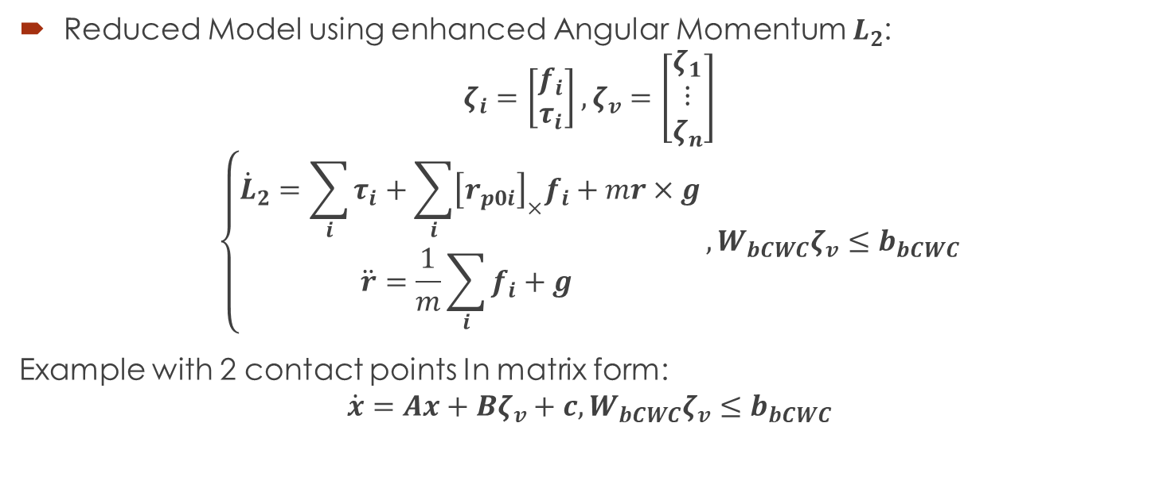
Full Centroidal Dynamics - FCD
Reduced Model using enhanced Angular Momentum $L_{2}$:
$$ζ_{i}=\left[\begin{aligned}f_{i} \\ τ_{i}\end{aligned}\right],ζ_{v}=\left[\begin{aligned}ζ_{1} \\ ⋮ \\ ζ_{n}\end{aligned}\right]$$
$$\left\{\begin{aligned}{\dot{L}}_{2}=\sum_{i}{τ_{i}}+\sum_{i}{{\left[r_{p0i}\right]}_{×}f_{i}}+mr×g \\ \ddot{r}=\frac{1}{m}\sum_{i}{f_{i}}+g \end{aligned}\right.,W_{bCWC}ζ_{v}≤b_{bCWC}$$
Example with 2 contact points In matrix form:
$$\dot{x}=Ax+Bζ_{v}+c,W_{bCWC}ζ_{v}≤b_{bCWC}$$

Slide 5
Full Centroidal Dynamics - FCD
First idea: Optimization:
$$\min_{ζ_{ne}}{\frac{1}{2}\int_{0}^{∞}{x_{e}^{T}Qx_{e}+ζ_{ne}^{T}Rζ_{ne}dt}}$$
Subject to:
$${\dot{x}}_{e}=Ax_{e}+Bζ_{ne}$$
$$W_{bCWC}ζ_{ve}≤b_{b3CWC}$$
$$x_{e}\left(0\right)=x_{e0}$$
Convex problem!

Slide 6
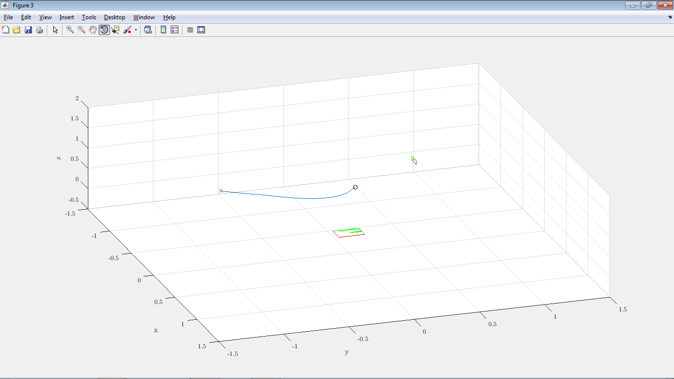
Full Centroidal Dynamics - FCD
First idea: QP Optimization on the discrete system:

Slide 7







LP for finding CoMs
Finding allowed CoMs for a fixed CWC (and fixed ${\dot{r}}_{0},L_{0}$): LP program:
1. Pick a random $r_{CoM0}$ (Stabilizable, example: a point on the static stability).
2. Pick a random ${\hat{v}}_{j}$. Can be defined by two angles (2D, i.e. angles from spherical coordinates).
3.$\max_{r_{CoM1},ζ_{nei},x_{ei}}\left(r_{CoM1}−r_{CoM0}\right)∙{\hat{v}}_{j}$ s.t
$$W_{CWC}ζ_{nei}≤b_{3CWC}$$
$$x_{ei+1}=x_{ei}+ΔT\left(Ax_{ei}+Bζ_{nei}\right)$$
$$x_{eN}=x_{ef}$$
$$x_{e0}=\left[\begin{aligned}L_{0}+m(r_{CoM1}×{\dot{r}}_{0}) \\ r_{CoM1}−r_{f} \\ {\dot{r}}_{0}\end{aligned}\right]$$
$$r_{CoM0}$$
$$r_{CoM1}$$
$${\hat{v}}_{j}$$
$${\hat{v}}_{j}$$
$$ζ$$

Slide 8
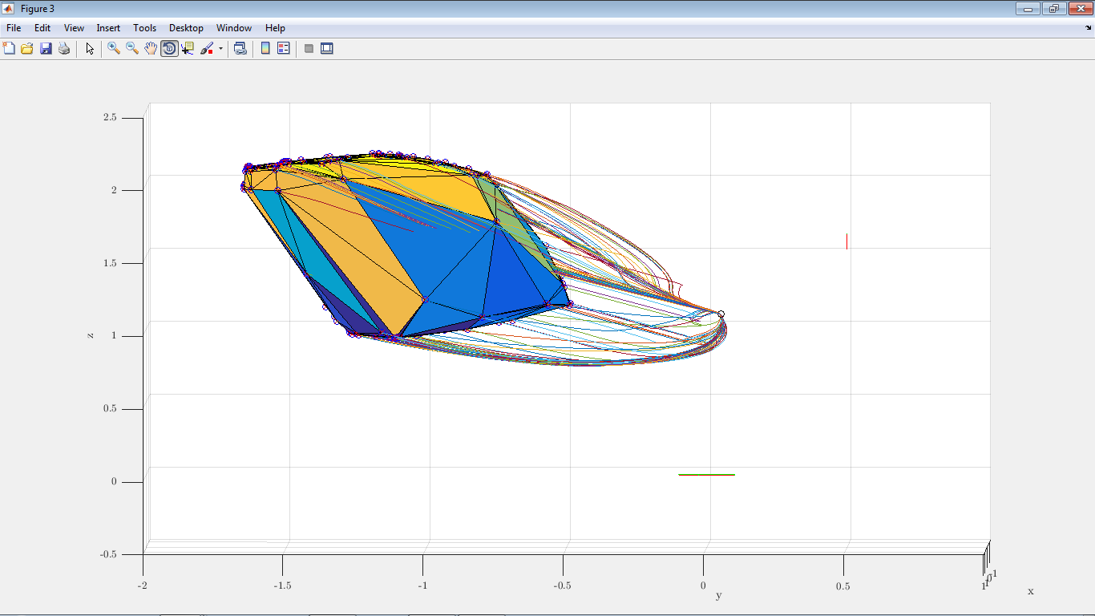
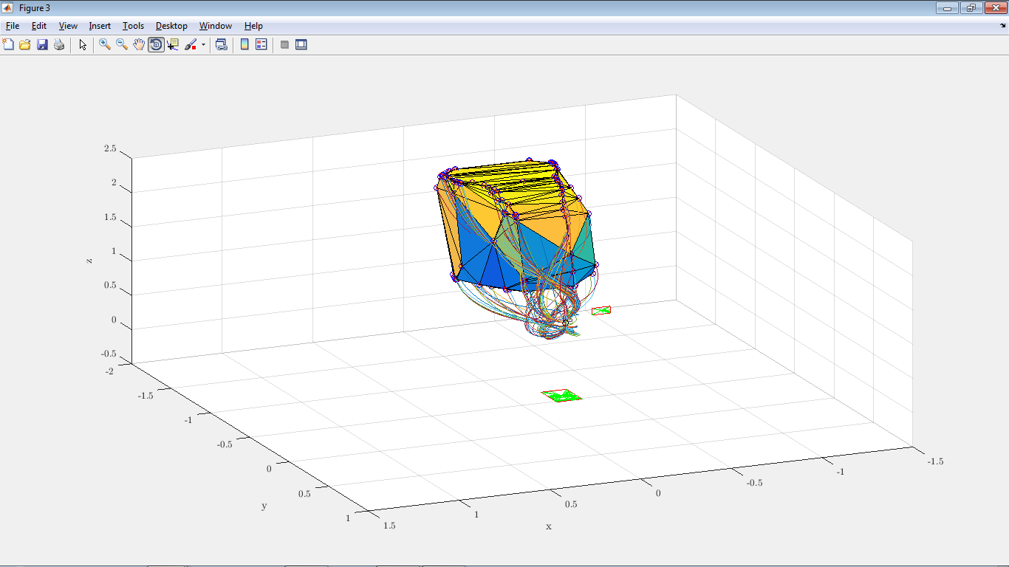
LP for finding CoMs
Finding allowed CoMs for a fixed CWC (and fixed ${\dot{r}}_{0},L_{0}$): LP program:

Slide 9
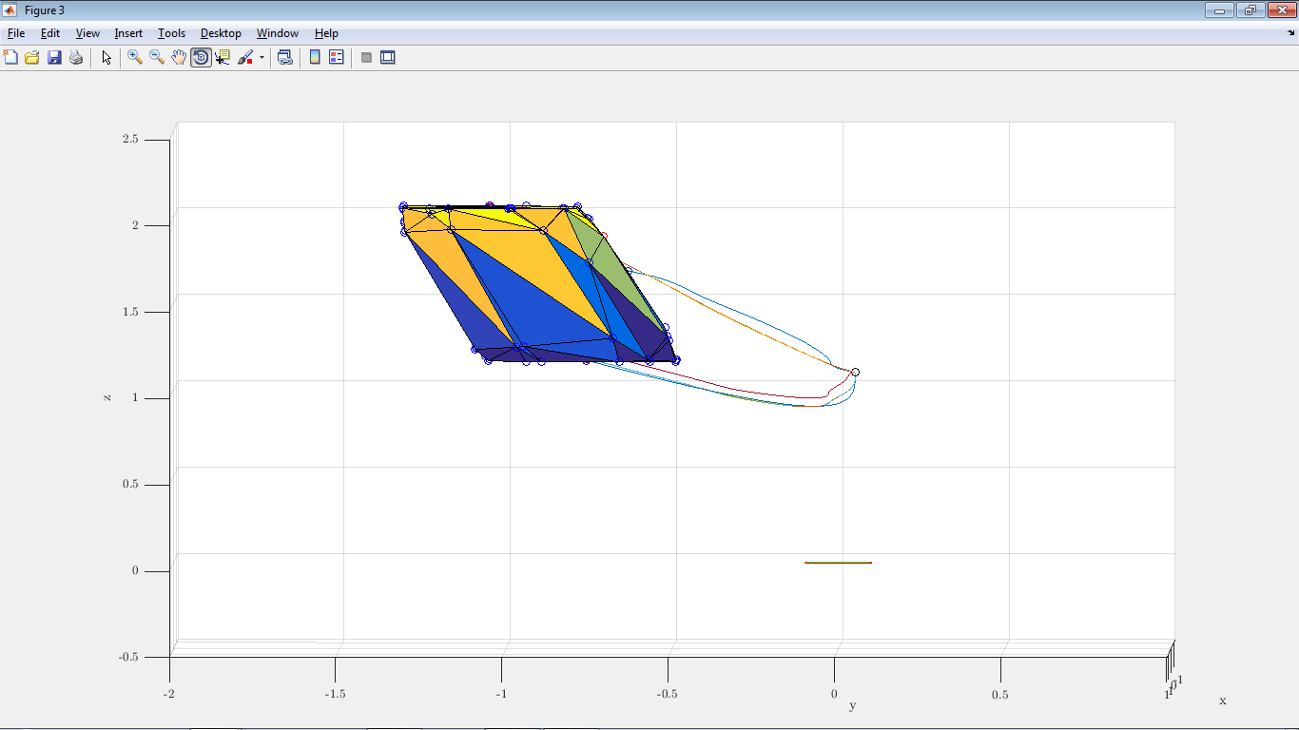
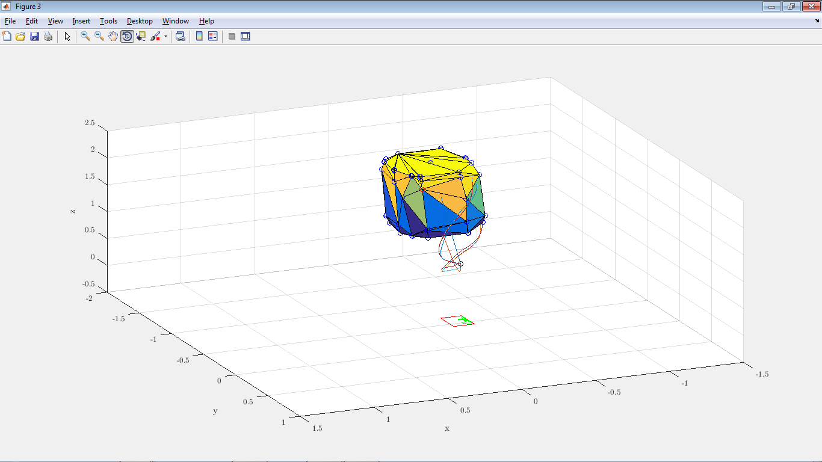
LP for finding CoMs
Without hand:

Slide 10
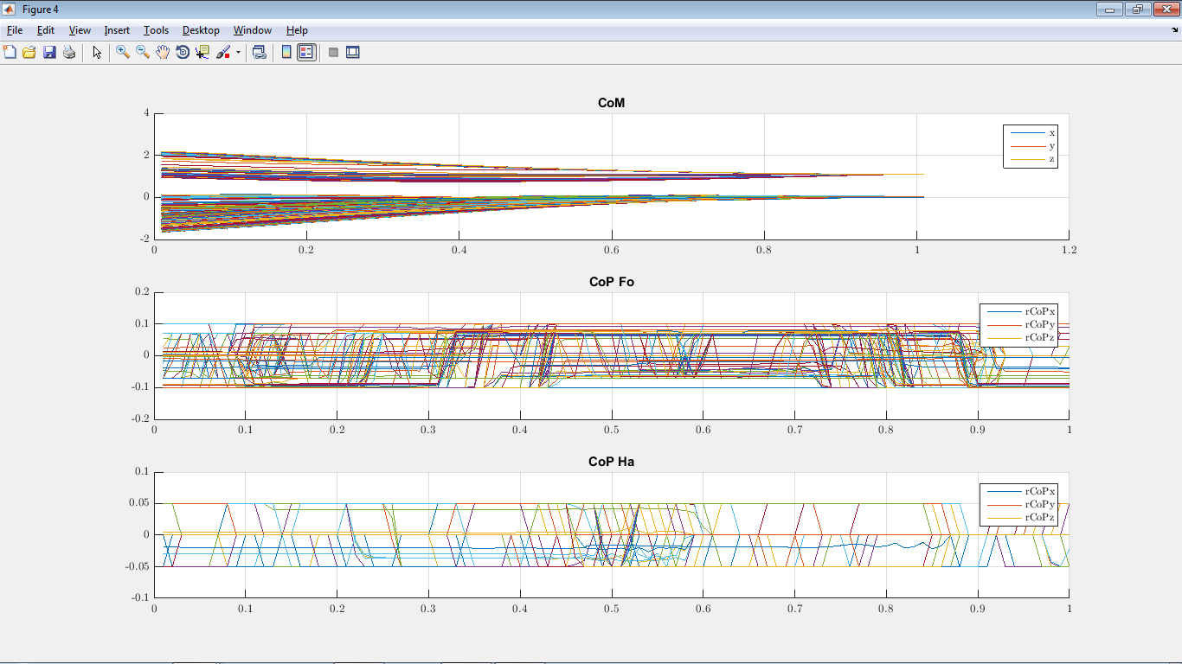
LP for finding CoMs
Finding allowed CoMs for a fixed CWC (and fixed ${\dot{r}}_{0},L_{0}$): LP program:

Slide 11




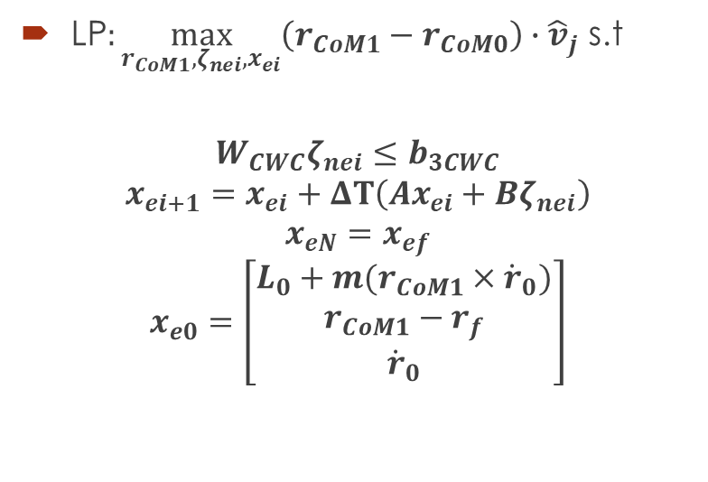

0-Step Capturability - FCD
Using the Full Centroidal Dynamics (FCD): If we can place instantaneously the foot, then we can step in the reflected region of:
LP$:\max_{r_{CoM1},ζ_{nei},x_{ei}}\left(r_{CoM1}−r_{CoM0}\right)∙{\hat{v}}_{j}$ s.t
$$W_{CWC}ζ_{nei}≤b_{3CWC}$$
$$x_{ei+1}=x_{ei}+ΔT\left(Ax_{ei}+Bζ_{nei}\right)$$
$$x_{eN}=x_{ef}$$
$$x_{e0}=\left[\begin{aligned}L_{0}+m(r_{CoM1}×{\dot{r}}_{0}) \\ r_{CoM1}−r_{f} \\ {\dot{r}}_{0}\end{aligned}\right]$$
$$r_{CoM0}$$
$$r_{CoM1}$$
$${\hat{v}}_{j}$$
$${\hat{v}}_{j}$$
$$ζ$$

Slide 12


0-Step Capturability w. Delay - FCD
If we can step after a given time $t_{st}$, then we can compute the states after this time:
$$\left\{\begin{aligned}\dot{L}=0 \\ \ddot{r}=g \end{aligned}\right.$$
$$\begin{matrix}L\left(t_{st}\right)=L_{0} \\ r\left(t_{st}\right)=r_{0}+{\dot{r}}_{0}t_{st}+\frac{1}{2}gt_{st}^{2} \\ \dot{r}\left(t_{st}\right)={\dot{r}}_{0}+gt_{st}\end{matrix}$$
$$r_{CoM0}$$
$$r_{CoM1}$$
$${\hat{v}}_{j}$$
$${\hat{v}}_{j}$$
$$ζ$$

Slide 13




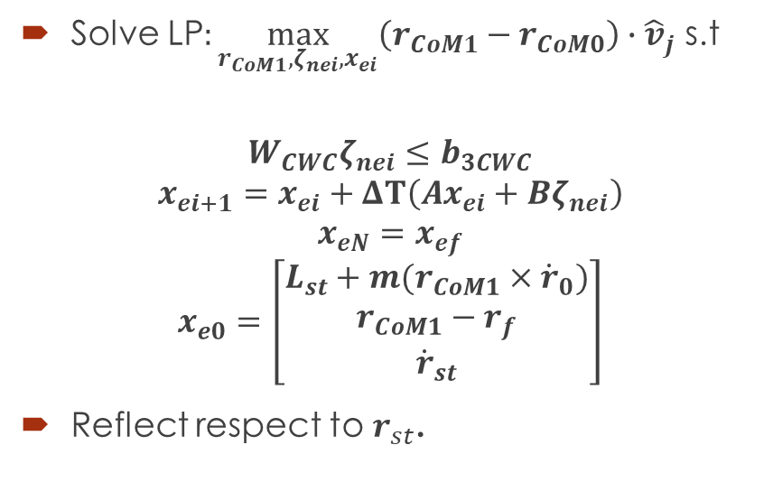

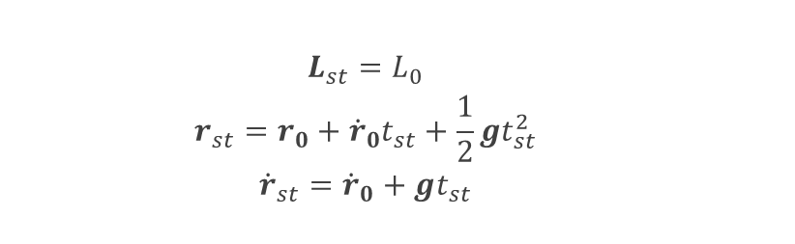
0-Step Capturability w. Delay - FCD
$$\begin{matrix}L_{st}=L_{0} \\ r_{st}=r_{0}+{\dot{r}}_{0}t_{st}+\frac{1}{2}gt_{st}^{2} \\ {\dot{r}}_{st}={\dot{r}}_{0}+gt_{st}\end{matrix}$$
Solve LP$:\max_{r_{CoM1},ζ_{nei},x_{ei}}\left(r_{CoM1}−r_{CoM0}\right)∙{\hat{v}}_{j}$ s.t
$$W_{CWC}ζ_{nei}≤b_{3CWC}$$
$$x_{ei+1}=x_{ei}+ΔT\left(Ax_{ei}+Bζ_{nei}\right)$$
$$x_{eN}=x_{ef}$$
$$x_{e0}=\left[\begin{aligned}L_{st}+m(r_{CoM1}×{\dot{r}}_{0}) \\ r_{CoM1}−r_{f} \\ {\dot{r}}_{st}\end{aligned}\right]$$
Reflect respect to $r_{st}$.
$$r_{CoM0}$$
$$r_{CoM1}$$
$${\hat{v}}_{j}$$
$${\hat{v}}_{j}$$
$$ζ$$

Slide 14

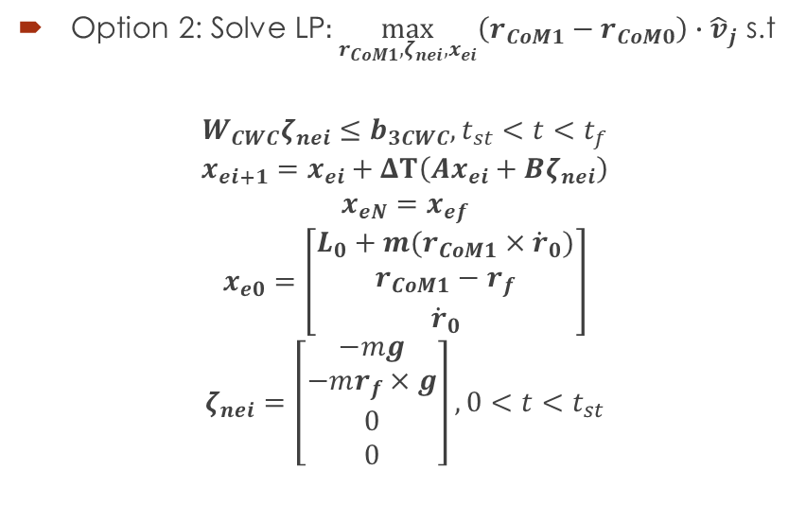




0-Step Capturability w. Delay - FCD
Option 2: Solve LP$:\max_{r_{CoM1},ζ_{nei},x_{ei}}\left(r_{CoM1}−r_{CoM0}\right)∙{\hat{v}}_{j}$ s.t
$$W_{CWC}ζ_{nei}≤b_{3CWC}, t_{st}<t<t_{f}$$
$$x_{ei+1}=x_{ei}+ΔT\left(Ax_{ei}+Bζ_{nei}\right)$$
$$x_{eN}=x_{ef}$$
$$x_{e0}=\left[\begin{aligned}L_{0}+m(r_{CoM1}×{\dot{r}}_{0}) \\ r_{CoM1}−r_{f} \\ {\dot{r}}_{0}\end{aligned}\right]$$
$$ζ_{nei}=\left[\begin{aligned}−mg \\ −mr_{f}×g \\ 0 \\ 0\end{aligned}\right], 0<t<t_{st}$$
$$r_{CoM0}$$
$$r_{CoM1}$$
$${\hat{v}}_{j}$$
$${\hat{v}}_{j}$$
$$ζ$$

Slide 15







1-Step Capturability – FCD
Where to place the next contact in order to get to complete rest:
$$ζ_{2}$$
$$ζ_{2}$$
$${\dot{r}}_{0}$$
$$L_{0}$$
???
$$r_{0}$$
$$ζ_{2}$$
$$ζ_{1}$$

Slide 16




1-Step Capturability – FCD
Let’s find the Next-Capture Point for a given planar surface.
$$ζ_{2}$$
$${\dot{r}}_{0}$$
$$L_{0}$$
$$ζ_{2}$$
$$r_{0}$$
$$ζ_{2}$$
$$ζ_{1}$$

Slide 17
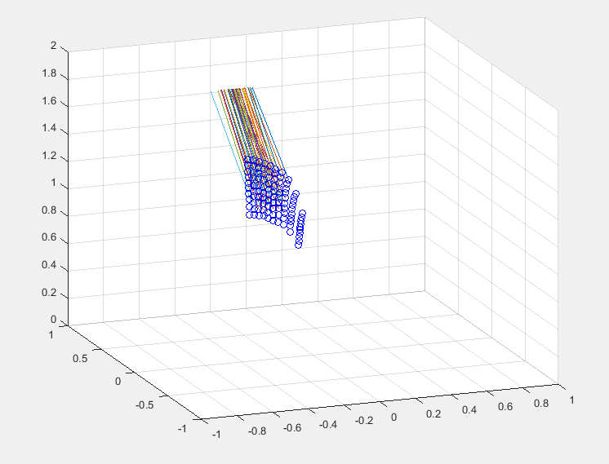
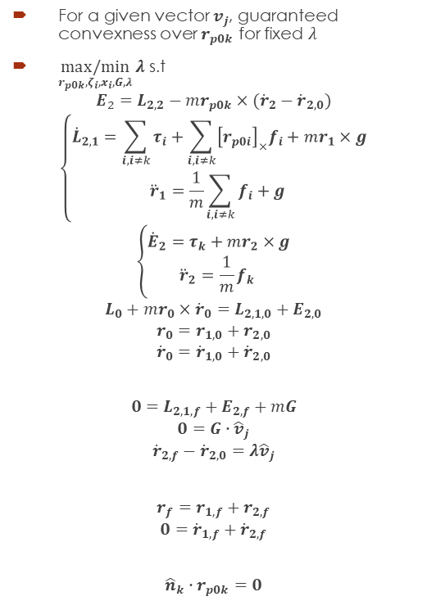

1-Step Capturability – FCD
Linear Program for finding some allowed hand positions:
For a given vector $v_{j}$, guaranteed convexness over $r_{p0k}$ for fixed $λ$
$\underset{r_{p0k},ζ_{i},x_{i},G,λ}{max/min}{λ}$ s.t
$$E_{2}=L_{2,2}−mr_{p0k}×({\dot{r}}_{2}−{\dot{r}}_{2,0})$$
$$\left\{\begin{aligned}{\dot{L}}_{2,1}=\sum_{i, i≠k}{τ_{i}}+\sum_{i, i≠k}{{\left[r_{p0i}\right]}_{×}f_{i}}+mr_{1}×g \\ {\ddot{r}}_{1}=\frac{1}{m}\sum_{i, i≠k}{f_{i}}+g \end{aligned}\right.$$
$$\left\{\begin{aligned}{\dot{E}}_{2}=τ_{k}+mr_{2}×g \\ {\ddot{r}}_{2}=\frac{1}{m}f_{k} \end{aligned}\right.$$
$$L_{0}+mr_{0}×{\dot{r}}_{0}=L_{2,1,0}+E_{2,0}$$
$$r_{0}=r_{1,0}+r_{2,0}$$
$${\dot{r}}_{0}={\dot{r}}_{1,0}+{\dot{r}}_{2,0}$$
$$0=L_{2,1,f}+E_{2,f}+mG$$
$$0=G∙{\hat{v}}_{j}$$
$${\dot{r}}_{2,f}−{\dot{r}}_{2,0}=λ{\hat{v}}_{j}$$
$$r_{f}=r_{1,f}+r_{2,f}$$
$$0={\dot{r}}_{1,f}+{\dot{r}}_{2,f}$$
$${\hat{n}}_{k}∙r_{p0k}=0$$
$$r_{p0k}=\frac{{\hat{n}}_{k}×G}{{\hat{n}}_{k}∙({\dot{r}}_{2,f}−{\dot{r}}_{2,0})}$$

Slide 18
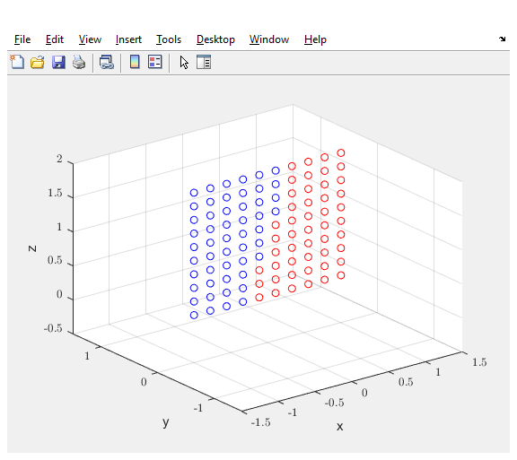
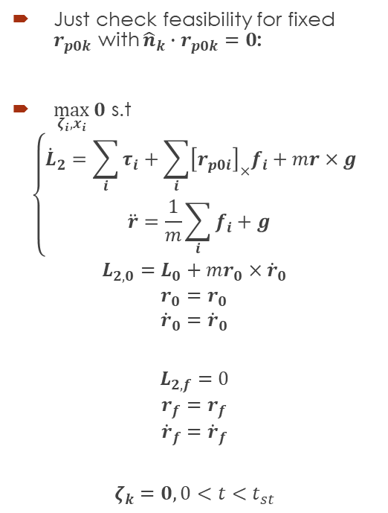
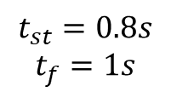
1-Step Capturability – FCD
Linear Program for finding vertex of allowed hand positions with time delay:
$$t_{st}=0.8s$$
$$t_{f}=1s$$
Just check feasibility for fixed $r_{p0k}$ with ${\hat{n}}_{k}∙r_{p0k}=0$:
$\max_{ζ_{i},x_{i}}{0}$ s.t
$$\left\{\begin{aligned}{\dot{L}}_{2}=\sum_{i}{τ_{i}}+\sum_{i}{{\left[r_{p0i}\right]}_{×}f_{i}}+mr×g \\ \ddot{r}=\frac{1}{m}\sum_{i}{f_{i}}+g \end{aligned}\right.$$
$$L_{2,0}=L_{0}+mr_{0}×{\dot{r}}_{0}$$
$$r_{0}=r_{0}$$
$${\dot{r}}_{0}={\dot{r}}_{0}$$
$$L_{2,f}=0$$
$$r_{f}=r_{f}$$
$${\dot{r}}_{f}={\dot{r}}_{f}$$
$$ζ_{k}=0, 0<t<t_{st}$$

Slide 19

Full Centroidal Dynamics - FCD
$$x=\left[\begin{aligned}L_{2} \\ r \\ \dot{r}\end{aligned}\right]$$
Improve first idea: Minimization of Angular momentum:
$$\min_{ζ}{\frac{1}{2}\int_{0}^{∞}{{\left\|L_{2}−m(r×\dot{r})\right\|}_{Q}^{2}dt}}$$
Subject to:
$$\dot{x}=Ax+Bζ+c$$
$$W_{bCWC}ζ≤b_{bCWC}$$
$$x\left(0\right)=x_{0}$$
$$x\left(t_{f}\right)=x_{f}$$

Slide 20
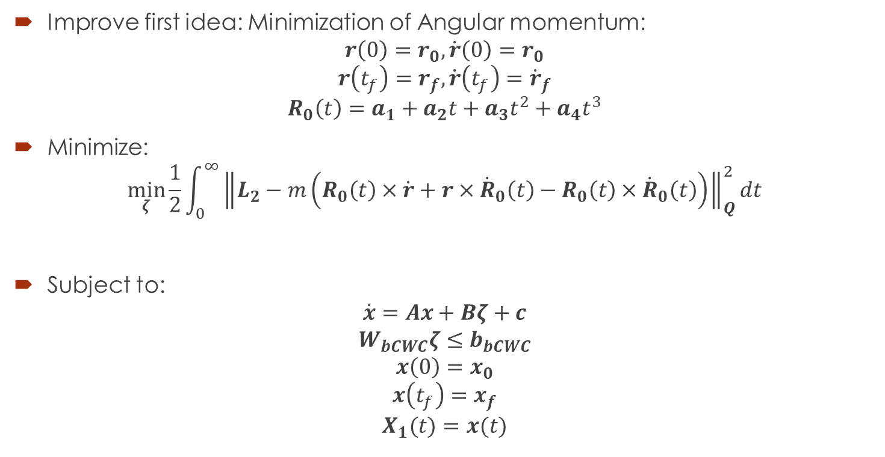
Full Centroidal Dynamics - FCD
Improve first idea: Minimization of Angular momentum:
$$r\left(0\right)=r_{0},\dot{r}\left(0\right)=r_{0}$$
$$r\left(t_{f}\right)=r_{f},\dot{r}\left(t_{f}\right)={\dot{r}}_{f}$$
$$R_{0}\left(t\right)=a_{1}+a_{2}t+a_{3}t^{2}+a_{4}t^{3}$$
Minimize:
$$\min_{ζ}{\frac{1}{2}\int_{0}^{∞}{{\left\|L_{2}−m\left(R_{0}\left(t\right)×\dot{r}+r×{\dot{R}}_{0}\left(t\right)−R_{0}\left(t\right)×{\dot{R}}_{0}\left(t\right)\right)\right\|}_{Q}^{2}dt}}$$
Subject to:
$$\dot{x}=Ax+Bζ+c$$
$$W_{bCWC}ζ≤b_{bCWC}$$
$$x\left(0\right)=x_{0}$$
$$x\left(t_{f}\right)=x_{f}$$
$$X_{1}(t)=x(t)$$

Slide 21
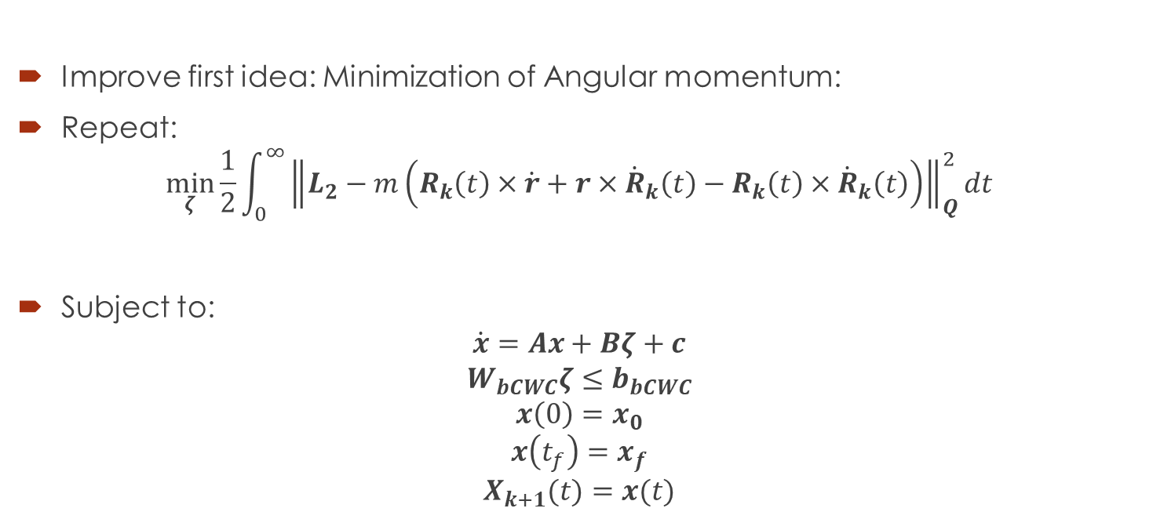
Full Centroidal Dynamics - FCD
Improve first idea: Minimization of Angular momentum:
Repeat:
$$\min_{ζ}{\frac{1}{2}\int_{0}^{∞}{{\left\|L_{2}−m\left(R_{k}\left(t\right)×\dot{r}+r×{\dot{R}}_{k}\left(t\right)−R_{k}\left(t\right)×{\dot{R}}_{k}\left(t\right)\right)\right\|}_{Q}^{2}dt}}$$
Subject to:
$$\dot{x}=Ax+Bζ+c$$
$$W_{bCWC}ζ≤b_{bCWC}$$
$$x\left(0\right)=x_{0}$$
$$x\left(t_{f}\right)=x_{f}$$
$$X_{k+1}(t)=x(t)$$

Slide 22

Full Centroidal Dynamics - FCD
Improve first idea: Minimization of Angular momentum:
Repeat:
$$\min_{ζ}{\frac{1}{2}\int_{0}^{∞}{x^{T}Q_{k}\left(t\right)x+q_{k}^{T}\left(t\right)xdt}}$$
Subject to:
$$\dot{x}=Ax+Bζ+c$$
$$W_{bCWC}ζ≤b_{bCWC}$$
$$x\left(0\right)=x_{0}$$
$$x\left(t_{f}\right)=x_{f}$$
$$X_{k+1}(t)=x(t)$$

Slide 23

Full Centroidal Dynamics - FCD
Improve first idea: Minimization of Angular momentum
Add additional regularization terms
Repeat:
$$\min_{ζ}{\frac{1}{2}\int_{0}^{∞}{x^{T}Q_{k}\left(t\right)x+q_{k}^{T}\left(t\right)x+α_{1}{\left\|r−R_{k}\left(t\right)\right\|}_{Q_{r}}^{2}+α_{2}{\left\|\dot{r}−{\dot{R}}_{k}\left(t\right)\right\|}_{Q_{\dot{r}}}^{2}+α_{3}{\left\|ζ−ζ_{k}\left(t\right)\right\|}_{R_{ζ}}^{2}+α_{4}{\left\|ζ\right\|}_{R}^{2}dt}}$$
Subject to:
$$\dot{x}=Ax+Bζ+c$$
$$W_{bCWC}ζ≤b_{bCWC}$$
$$x\left(0\right)=x_{0}$$
$$x\left(t_{f}\right)=x_{f}$$
$$X_{k+1}(t)=x(t)$$

Slide 24
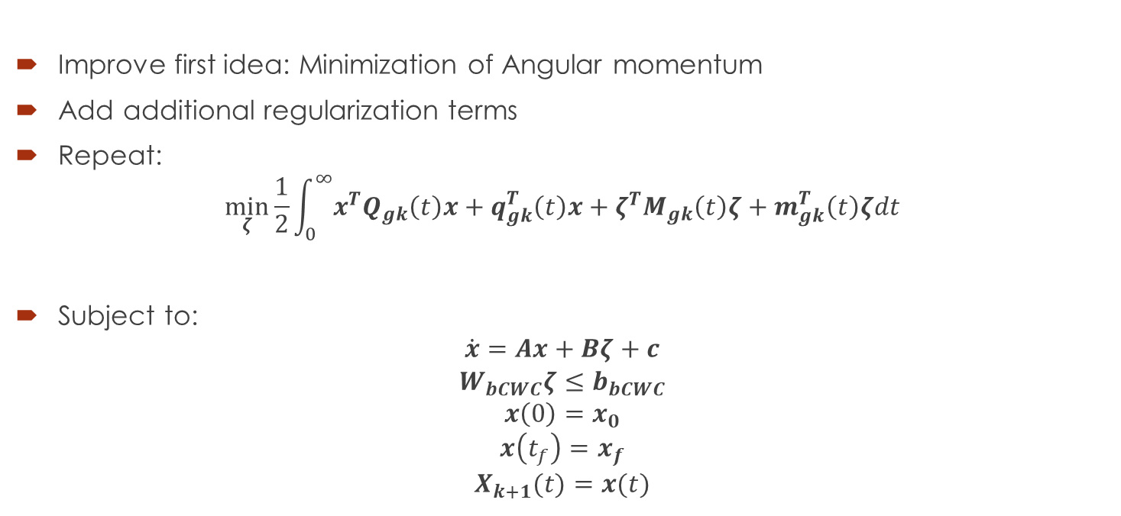
Full Centroidal Dynamics - FCD
Improve first idea: Minimization of Angular momentum
Add additional regularization terms
Repeat:
$$\min_{ζ}{\frac{1}{2}\int_{0}^{∞}{x^{T}Q_{gk}\left(t\right)x+q_{gk}^{T}\left(t\right)x+ζ^{T}M_{gk}\left(t\right)ζ+m_{gk}^{T}\left(t\right)ζdt}}$$
Subject to:
$$\dot{x}=Ax+Bζ+c$$
$$W_{bCWC}ζ≤b_{bCWC}$$
$$x\left(0\right)=x_{0}$$
$$x\left(t_{f}\right)=x_{f}$$
$$X_{k+1}(t)=x(t)$$

Slide 25
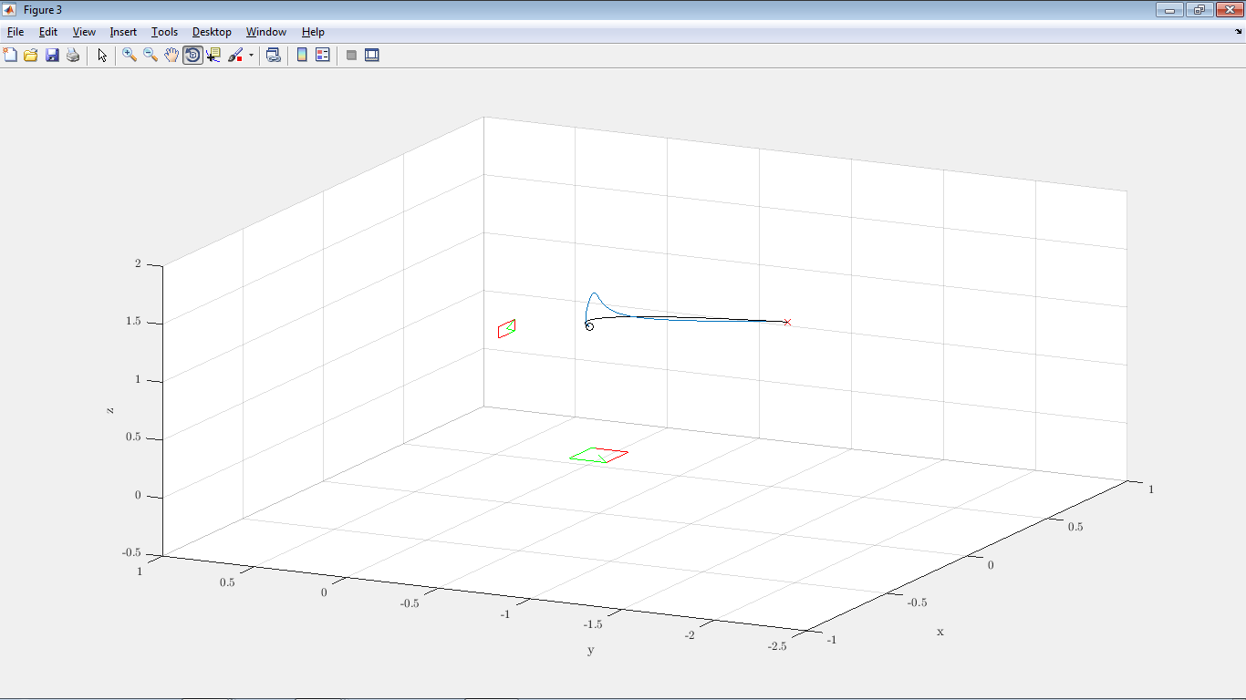
Full Centroidal Dynamics - FCD
Improve first idea: Minimization of Angular momentum

Slide 26
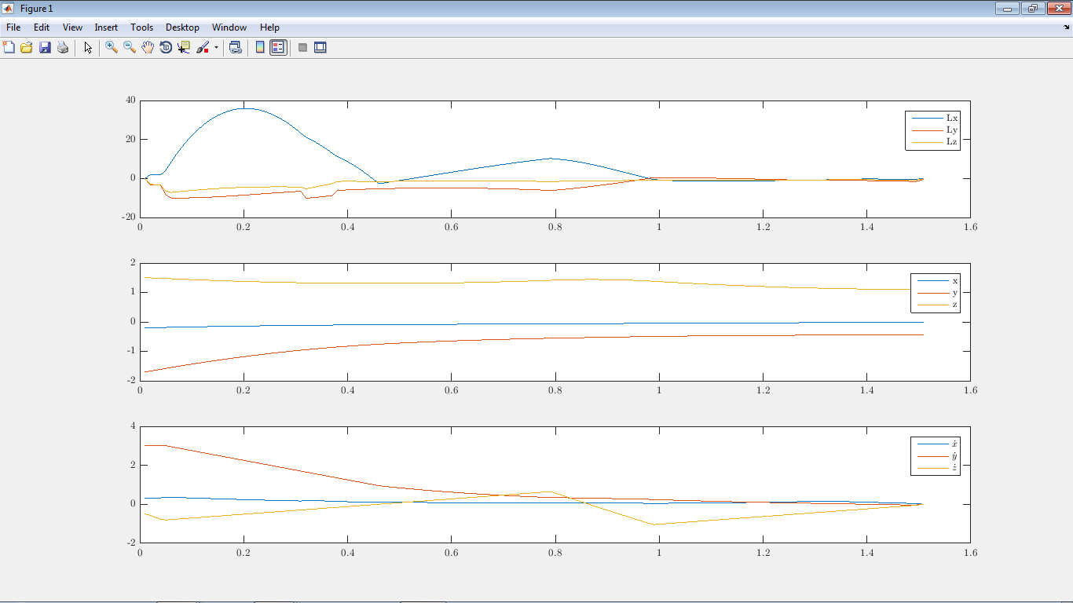
Full Centroidal Dynamics - FCD
Improve first idea: Minimization of Angular momentum

Slide 27

Full Centroidal Dynamics - FCD
Improve first idea: Minimization of Angular momentum

Slide 28
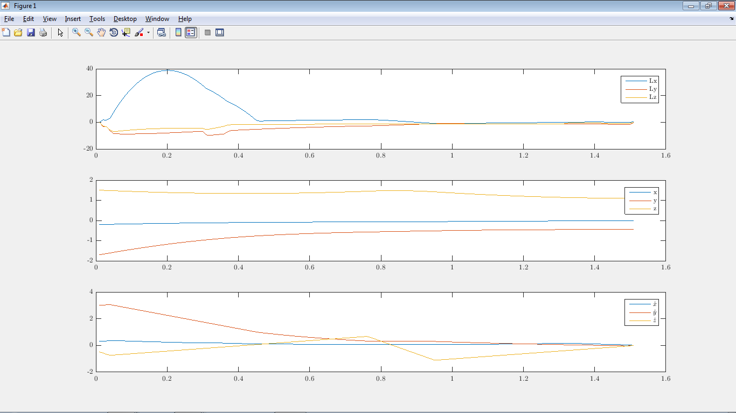
Full Centroidal Dynamics - FCD
Improve first idea: Minimization of Angular momentum

Slide 29

Topic: Height Variations
Single contact/Planar contacts:
$$\left[\dot{\begin{aligned}L \\ \ddot{r}\end{aligned}}\right]=\left[\begin{aligned}τ_{n}\hat{n}+f_{gr}×\left(r−r_{P}\right) \\ \frac{1}{m}f_{gr}+g\end{aligned}\right]$$
s.t.
$$Ar_{P}≤b$$
$$f_{gr}∙\hat{n}≥0$$

Slide 30

Topic: Height Variations
Forcing Constant Angular Momentum:
$$τ_{n}=0$$
$$f_{gr}=mu\left(r−r_{P}\right)$$
$$\ddot{r}\left(t\right)=u\left(r−r_{P}\right)+g$$
s.t.
$$Ar_{P}≤b$$
$$u≥0$$

Slide 31
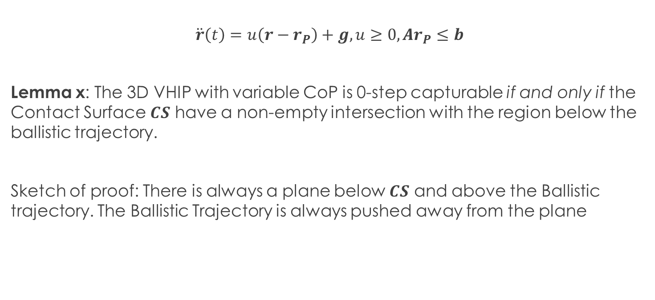
Topic: Height Variations
$$\ddot{r}\left(t\right)=u\left(r−r_{P}\right)+g, u≥0,Ar_{P}≤b$$
Lemma x: The 3D VHIP with variable CoP is 0-step capturable if and only if the Contact Surface $CS$ have a non-empty intersection with the region below the ballistic trajectory.
Sketch of proof: There is always a plane below $CS$ and above the Ballistic trajectory. The Ballistic Trajectory is always pushed away from the plane

Slide 32

3D VHIP and Motion Descomposition
$$\ddot{r}\left(t\right)=u\left(r−r_{P}\right)+g, u≥0,Ar_{P}≤b$$
Augmented 3D VHIP w. Variable CoP:
$$\left[\begin{aligned}{\dot{T}}_{g}=−1+T_{g}^{2}u \\ \ddot{r}\left(t\right)=u\left(r−r_{P}\right)+g\end{aligned}\right], u≥0$$

Slide 33
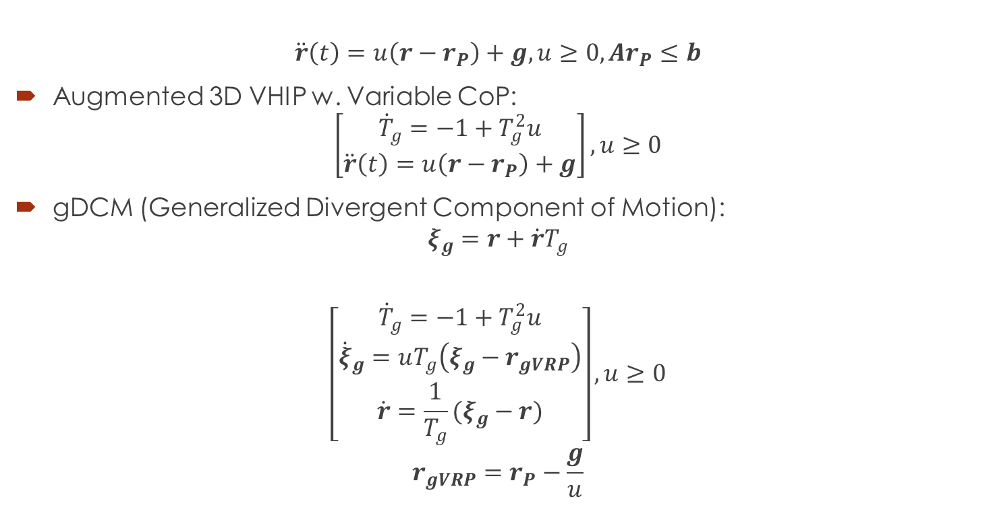
3D VHIP and Motion Descomposition
$$\ddot{r}\left(t\right)=u\left(r−r_{P}\right)+g, u≥0,Ar_{P}≤b$$
Augmented 3D VHIP w. Variable CoP:
$$\left[\begin{aligned}{\dot{T}}_{g}=−1+T_{g}^{2}u \\ \ddot{r}\left(t\right)=u\left(r−r_{P}\right)+g\end{aligned}\right], u≥0$$
gDCM (Generalized Divergent Component of Motion):
$$ξ_{g}=r+\dot{r}T_{g}$$
$$\left[\begin{aligned}{\dot{T}}_{g}=−1+T_{g}^{2}u \\ {\dot{ξ}}_{g}=uT_{g}\left(ξ_{g}−r_{gVRP}\right) \\ \dot{r}=\frac{1}{T_{g}}(ξ_{g}−r)\end{aligned}\right], u≥0$$
$$r_{gVRP}=r_{P}−\frac{g}{u}$$

Slide 34

3D VHIP and Motion Descomposition
$$\ddot{r}\left(t\right)=u\left(r−r_{P}\right)+g, u≥0,Ar_{P}≤b$$
Use instead: $φ≔r_{IBT}\left(T_{g}\right)=r+\dot{r}T_{g}+\frac{g}{2}{T_{g}}^{2}=ξ_{g}+\frac{g}{2}{T_{g}}^{2}$
$$\left[\begin{aligned}{\dot{T}}_{g}=−1+T_{g}^{2}u \\ {\dot{z}}_{cg}=uT_{g}\left(z_{cg}−\frac{g}{2}T_{g}^{2}\right)\end{aligned}\right]$$
$$\left[\begin{aligned}{\dot{ξ}}_{gxy}=uT_{g}\left(ξ_{gxy}−r_{pxy}\right)\end{aligned}\right]$$
$$\left[\begin{aligned}{\dot{r}}_{xy}=\frac{1}{T_{g}}\left(ξ_{gxy}−r_{xy}\right) \\ \dot{z}=\frac{1}{T_{g}}(z_{cg}+\frac{g}{2}T_{g}^{2}−z)\end{aligned}\right]$$

Slide 35
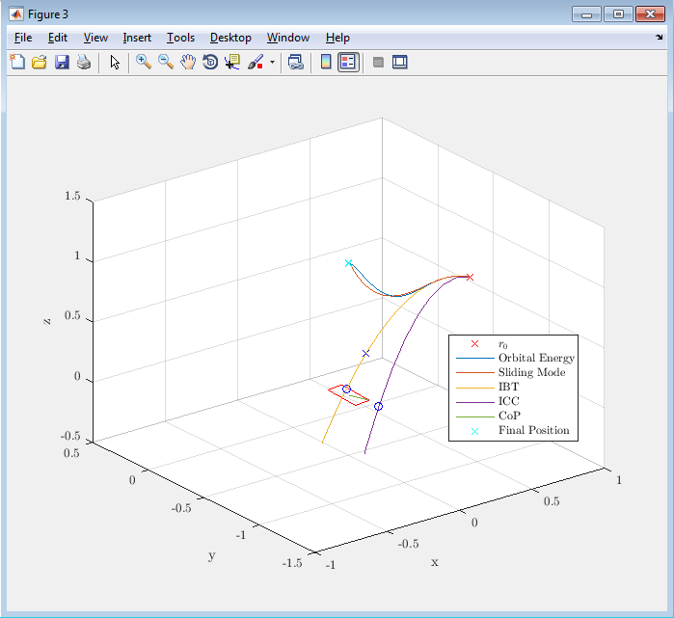

3D VHIP and Motion Descomposition
$$\ddot{r}\left(t\right)=u\left(r−r_{P}\right)+g, u≥0,Ar_{P}≤b$$

Slide 36
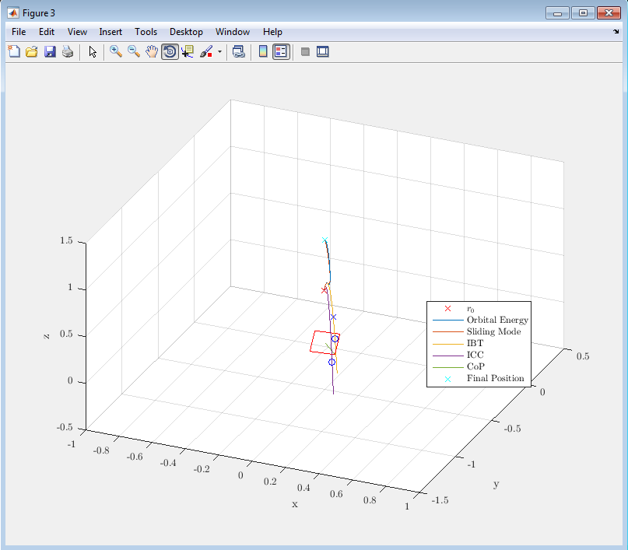
3D VHIP and Motion Descomposition
$$\ddot{r}\left(t\right)=u\left(r−r_{P}\right)+g, u≥0,Ar_{P}≤b$$

Slide 37
Next?
Finish 3D VHIP Paper.
Finish FCD Paper.
Thanks!

